Slide 1
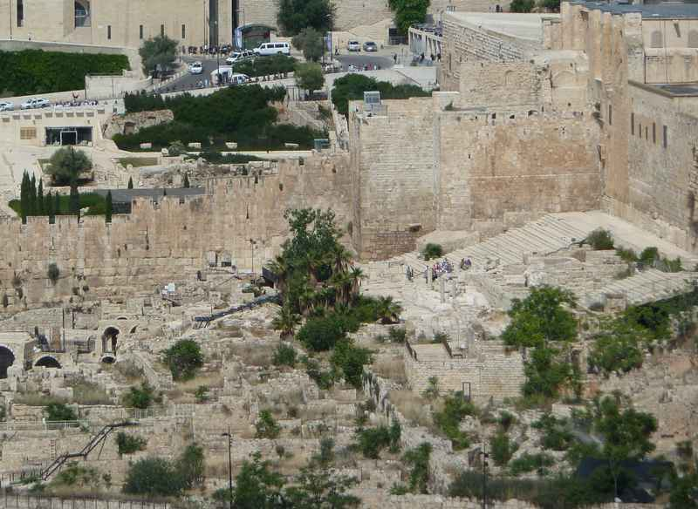

Slide 2
John 20.30-31: “Now Jesus performed many other miraculous signs in the presence of the disciples, which are not recorded in this book. But these are recorded so that you may believe that Jesus is the Christ, the Son of God, and that by believing you may have life in his name.”

Slide 3
Christ = Χριστός
Messiah = מָשִׁיחַ
Christ = Messiah = the anointed one

Slide 4
Genesis 3.15 NASB: “And I will put enmity between you and the woman, and between your seed and her seed; He shall bruise you on the head, and you shall bruise him on the heel.”

Slide 5
Acts 3.19-23 NIV: “Repent, then, and turn to God, so that your sins may be wiped out, that times of refreshing may come from the Lord, and that he may send the Messiah, who has been appointed for you-- even Jesus. Heaven must receive him until the time comes for God to restore everything, as he promised long ago through his holy prophets. For Moses said, ‘The Lord your God will raise up for you a prophet like me from among your own people; you must listen to everything he tells you. Anyone who does not listen to him will be completely cut off from their people.’”

Slide 6
Psalm 2.1-12 NLT: “…the rulers plot together against the LORD and against his anointed one …For the Lord declares, ‘I have placed my chosen king on the throne in Jerusalem, on my holy mountain.’ The king proclaims the LORD's decree: ‘The LORD said to me, “You are my son. Today I have become your Father... Submit to God's royal son, or he will become angry, and you will be destroyed in the midst of all your activities-- for his anger flares up in an instant. But what joy for all who take refuge in him!”

Slide 7
Isaiah 7.14 NASB:
“Therefore the Lord Himself will give you a sign: Behold, a virgin will be with child and bear a son, and she will call His name Immanuel.”

Slide 8
Isaiah 9.6-7 NASB: “For a child will be born to us, a son will be given to us; And the government will rest on His shoulders; And His name will be called Wonderful Counselor, Mighty God, Eternal Father, Prince of Peace. There will be no end to the increase of His government or of peace, On the throne of David and over his kingdom, To establish it and to uphold it with justice and righteousness From then on and forevermore. The zeal of the LORD of hosts will accomplish this.”

Slide 9
Isaiah 53.5-6 NASB: “But He was pierced through for our transgressions, He was crushed for our iniquities; The chastening for our well-being fell upon Him, And by His scourging we are healed. All of us like sheep have gone astray, Each of us has turned to his own way; But the LORD has caused the iniquity of us all To fall on Him.”

Slide 10
Jeremiah 23.5-6 NASB: “‘Behold, the days are coming,’ declares the LORD, ‘When I will raise up for David a righteous Branch; And He will reign as king and act wisely And do justice and righteousness in the land. In His days Judah will be saved, And Israel will dwell securely; And this is His name by which He will be called, “The LORD our righteousness.”’”

Slide 11
Zechariah 6.13 NASB: “Yes, it is He who will build the temple of the LORD, and He who will bear the honor and sit and rule on His throne. Thus, He will be a priest on His throne, and the counsel of peace will be between the two offices.”

Slide 12
John 1.1, 14 NET: “In the beginning was the Word, and the Word was with God, and the Word was fully God… ¹⁴ Now the Word became flesh and took up residence among us. We saw his glory– the glory of the one and only, full of grace and truth, who came from the Father.”

Slide 13
John 3.14-18 NET: “‘Just as Moses lifted up the serpent in the wilderness, so must the Son of Man be lifted up, so that everyone who believes in him may have eternal life.’ For this is the way God loved the world: He gave his one and only Son, so that everyone who believes in him will not perish but have eternal life. For God did not send his Son into the world to condemn the world, but that the world should be saved through him. The one who believes in him is not condemned. The one who does not believe has been condemned already, because he has not believed in the name of the one and only Son of God.”

Slide 14
Divine & Human
* eternal Son born as baby
God’s Anointed
* greatest prophet
Jesus * permanent high priest
* heir to David’s throne
Savior / Deliverer
* reconcile us with God
* pay our penalty for sin

Slide 15
John 1.12-13 NET “But to all who have received him– those who believe in his name– he has given the right to become God's children – children not born by human parents or by human desire or a husband's decision, but by God.”
John 3.16 NET: “For this is the way God loved the world: He gave his one and only Son, so that everyone who believes in him will not perish but have eternal life.”

Slide 16
John 3.36 NET: “The one who believes in the Son has eternal life. The one who rejects the Son will not see life, but God's wrath remains on him.”
John 6.40 NET: “For this is the will of my Father– for everyone who looks on the Son and believes in him to have eternal life, and I will raise him up at the last day.”

